Slide 1


To Install or Not to Install: Why Businesses Choose On-Site Renewable Energy
Michelle Miilu
MA Office of Technical Assistance
National Environmental Partnership Summit
May 11, 2006

Slide 2
Background
Renewable energy lead for office
Concern about low % of manufacturers applying for state grants
Driving forces and common ground
Tool to identify good candidates

Slide 3
Information Sources
Industry organizations
State funding organizations
Businesses with on-site renewables
Industry currently in the installation process

Slide 4
Types of Businesses
Food processors
Plastics
Pharmaceuticals
Aluminum extrusion
Semiconductors
Inverter manufacturer
Beauty salon

Slide 5
Main Concerns for Those That Install
COST/BENEFIT
ENVIRONMENTAL

Slide 6
Cost/Benefit
Paybacks typically 5-10 years
Certainty about future energy prices
Large energy users minimize or cut costs while growing business
Stay competitive

Slide 7
Environmental
Reliance on fossil fuels
GHG emissions
Concern for employees
Positive affect on regional air quality

Slide 8
Technology-Specific Concerns
Availability of resource
Structural/roof issues
Efficiency of technology

Slide 9
On-site Renewable Energy is Not for Everyone
Struggling businesses
Low energy prices
No energy efficiency effort
Upper-level commitment is important

Slide 10
How to Choose the Right Renewable
Availability of resource
Energy demand of business
Community acceptance

Slide 11
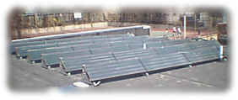
Good Solar Hot Water Candidates
Have a relatively large demand for hot water
Year around direct
sun from 9am-4pm
Space for installation
Structurally sound location
Beauty salons | Plating
Laundries | Textiles
Food processing | Pulp & paper

Slide 12
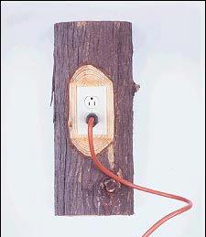
Good Biomass Candidates
Proximity to resource
Demand for heat
Sufficient space

Slide 13
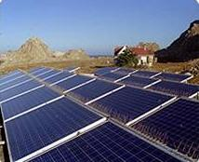
Good PV Candidates
Preferred installation area: flat or SW-SE facing, structurally sound, low-cost, minimal obstructions or shading
If roof PV, where roof will not require replacement soon
Where surcharges for peak electricity exist

Slide 14
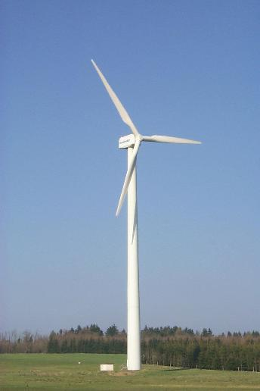
Good Wind Candidates
24/7 operations
>1000ft from nearest residence
Class 3 or better wind (6.5m/s at hub height)
On hill tops
Away from trees, airports, and sandy soil

Slide 15

Fresh Hair - Solar Thermal
Full service beauty salon
Considered PV, but too expensive
Projected 8yr payback
$9,400 50-60MBtu/yr project, ~3/4 of need
Tax incentives pay 40%, no grant money
Pro: Investment in company and environment
Con: Water out for 1-2 days during installation and a couple hours during annual maintenance

Slide 16

Harbec Plastics - Wind
Injection molder
Considered solar, but better wind resource
Projected 8-9yr payback
$375K 250kW project, no grants or tax benefits
Pro: Everyone knows Harbec is environmentally responsible even if they don’t know what Harbec does
Con: Took 13 months to get planning board approval

Slide 17

Bixby - PV
Plastic sheet extruder
Considered wind, but initial investment too high
Projected 6-7yr payback
$345K 51kW project, $257K in tax incentives and state grants
Pro: A lot of publicity
Con: Cloudier winter than expected

Slide 18
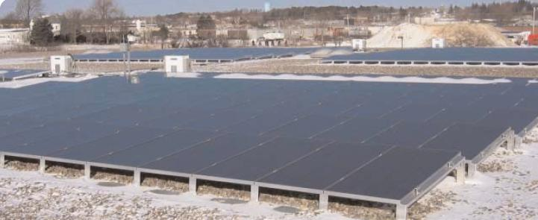

Slide 19
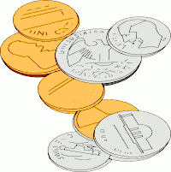
Things That Renewables Owners Would Change
Location
Equipment
  Type
  Efficiency
  Manufacturer
Sooner!

Slide 20
Other Items That May Concern You
#1 complaint was that the process took longer than expected
Except for Fresh Hair, renewables have been completely transparent to production operations
Everyone said they’d do it again if they had it to do over

Slide 21

Note to Assistance Providers…
Many companies pursued on-site renewables as a result of direct outreach!
  Fresh Hair
  Bixby
  Cordis
  Varian Semiconductor

Slide 22

Questions??

